Slide 2

Data Analytics with R – Mini Project
Stroke Predictor Submitted by:
Pasang Gurung | 20171CSE0491
Prajwal Gowda S | 20171CSE518
Prakyath S Arya | 20171CSE0523
Prathyaksh NP | 20171CSE0529
Preetham CD | 20171CSE0532

Slide 3

Introduction
Data analytics typically means analyzing raw data for insights, pattern, knowledge and information.
The information extracted from Data analytics can be used with machine learning algorithms like predictions, clustering, generating rules etc.
Stroke is a medical condition in which damage to the brain occurs from interruption of its blood supply.
If it is not identified at an early stage it may lead to conditions like trouble in walking, speaking and understanding, as well as paralysis or numbness of the face, arm or leg.
Hence, we have proposed a machine that will predict the risk of having a stroke based on attributes given by the user.
The algorithm used is a Supervised Classification Algorithm called Logistic Regression and is implemented using the language ‘R’.

Slide 4


Requirements
Software Requirements
R Compiler, R 3.6 or higher
A GUI library, RGtk2
A Data manipulation library, CaTools
Data visualization packages, ggplot2 and plotrix
Decision tree plot package, rpart and rpart.plot
Hardware Requirements
An intel-compatible PC with R installed
34 bit or 64 bit architecture
A RAM of least 2 GB
A processor of 2.5Ghz or higher

Slide 5

User Interface
The Graphical User Interface (GUI) is designed using an open source GUI library called RGtk2.
# Install package install.package(RGtk2)
# Include the library library(RGtk2)
The interface has widgets like:
Title Bar
Inputs text fields
Dropdown list selection boxes
Buttons
Pop up messages to display messages and results

Slide 6
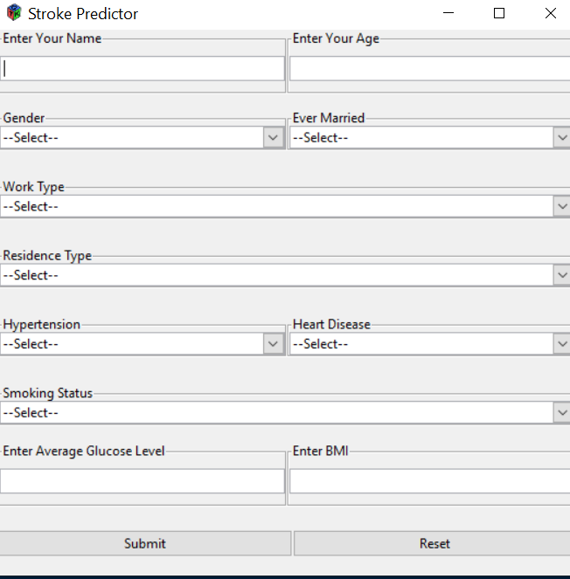
User Interface
Input Fields:
Text entry boxes:
Name [String]
Age [Numeric]
Average glucose level [Numeric]
BMI [Numeric]
Dropdown Selection boxes:
Gender [Male, Female]
Ever married [Yes, No]
Work type [Private, Government, Self-employed]
Residence type [Urban, Rural]
Hypertension [Yes, No]
Heart Disease [Yes, No]
Smoking status [Currently smokes, Formerly smoked, Never smoked]
Buttons:
Submit button [To submit the form and start prediction]
Reset button [To reset the form]

Slide 7
User Interface
Code for the main window
# Create main window window = gtkWindow("toplevel", show = FALSE)
# Add title to the window gtkWindowSetTitle(window, "Stroke Predictor")
# Set window width and height gtkWindowSetDefaultSize(window, 530, 500)
# Create a box to enclose widgets box <- gtkVBox(TRUE, 8)
# Add all contents to the window window$add(box)
# Show the window window$show()

Slide 8
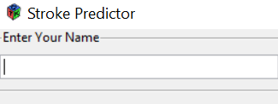
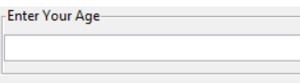
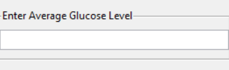
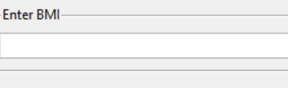
User Interface – Text widgets
# Name name_frame <- gtkFrame("Enter Your Name") name = gtkEntryNew(show = TRUE) name_frame$add(name) box$packStart(name_frame, fill = TRUE)
# Age age_frame <- gtkFrame("Enter Your Age") age = gtkEntryNew(show = TRUE) age_frame$add(age) box$packStart(age_frame, fill = TRUE)
# Glucose Level glucose_frame <- gtkFrame("Enter Average Glucose Level") glucose = gtkEntryNew(show = TRUE) glucose_frame$add(glucose) box$packStart(glucose_frame, fill = TRUE)
# BMI bmi_frame <- gtkFrame("Enter BMI") bmi = gtkEntryNew(show = TRUE) bmi_frame$add(bmi) box$packStart(bmi_frame, fill = TRUE)

Slide 9
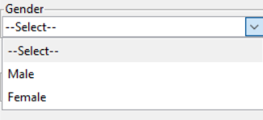
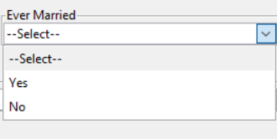
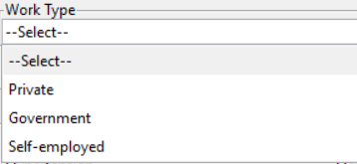
User Interface – Dropdown widgets
# Dropdown for Gender gender_frame <- gtkFrame("Gender") choiceList = c("--Select--", "Male", "Female") gender <- gtkComboBoxNewText() for (i in choiceList) gender$appendText(i) gender$setActive(0) gender_frame$add(gender) box$packStart(gender_frame, fill = TRUE)
# Dropdown for Marital status ever_married_frame <- gtkFrame("Ever Married") choiceList = c("--Select--", "Yes", "No") ever_married <- gtkComboBoxNewText() for (i in choiceList) ever_married$appendText(i) ever_married$setActive(0) ever_married_frame$add(ever_married)
# Dropdown for Work type work_type_frame <- gtkFrame("Work Type") choiceList = c("--Select--", "Private", "Government", "Self-employed") work_type <- gtkComboBoxNewText() for (i in choiceList) work_type$appendText(i) work_type$setActive(0) work_type_frame$add(work_type)

Slide 10
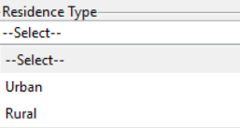
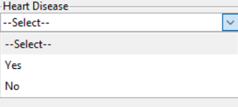
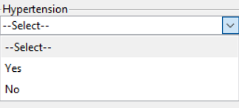
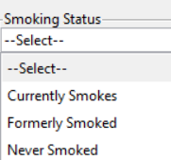
User Interface – Dropdown widgets
# Dropdown for Residence type residence_type_frame <- gtkFrame("Residence Type") choiceList = c("--Select--", "Urban", "Rural") residence_type <- gtkComboBoxNewText() for (i in choiceList) residence_type$appendText(i) residence_type$setActive(0) residence_type_frame$add(residence_type)
# Dropdown for Hypertension and Heart disease hyper_heart_frame <- gtkFrame(“Hypertension and Heart Disease") choiceList = c("--Select--", "Yes", "No") heart_disease <- gtkComboBoxNewText() hypertension <- gtkComboBoxNewText() for (i in choiceList) heart_disease$appendText(i) hypertension$appendText(i) heart_disease$setActive(0) hypertension$setActive(0) hyper_heart_frame$add(heart_disease)
# Dropdown for Smoking status smoking_type_frame <- gtkFrame("Smoking Status") choiceList = c("--Select--", "Currently Smokes", "Formerly Smoked", "Never Smoked") smoking_type <- gtkComboBoxNewText() for (i in choiceList) smoking_type$appendText(i) smoking_type$setActive(0) smoking_type_frame$add(smoking_type) box$packStart(smoking_type_frame, fill = FALSE)

Slide 11
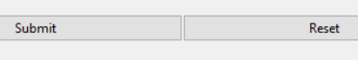
User Interface - Buttons
submit = gtkButton("Submit") gSignalConnect(submit, "clicked", function(e){submit_function()})
submit = function(){ # Access all widget values result = predictor(widget_values) # Display the result }
reset = gtkButton(“Reset") gSignalConnect(reset, "clicked", function(e){reset_function()})
reset = function(){ # Access all widgets # Clear all values }

Slide 12
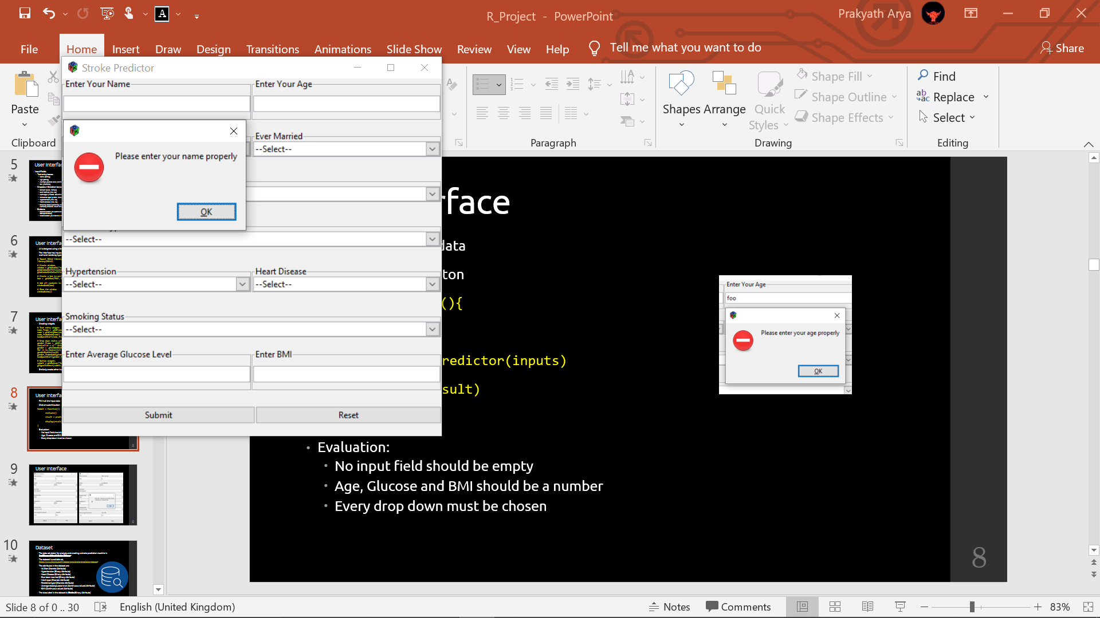
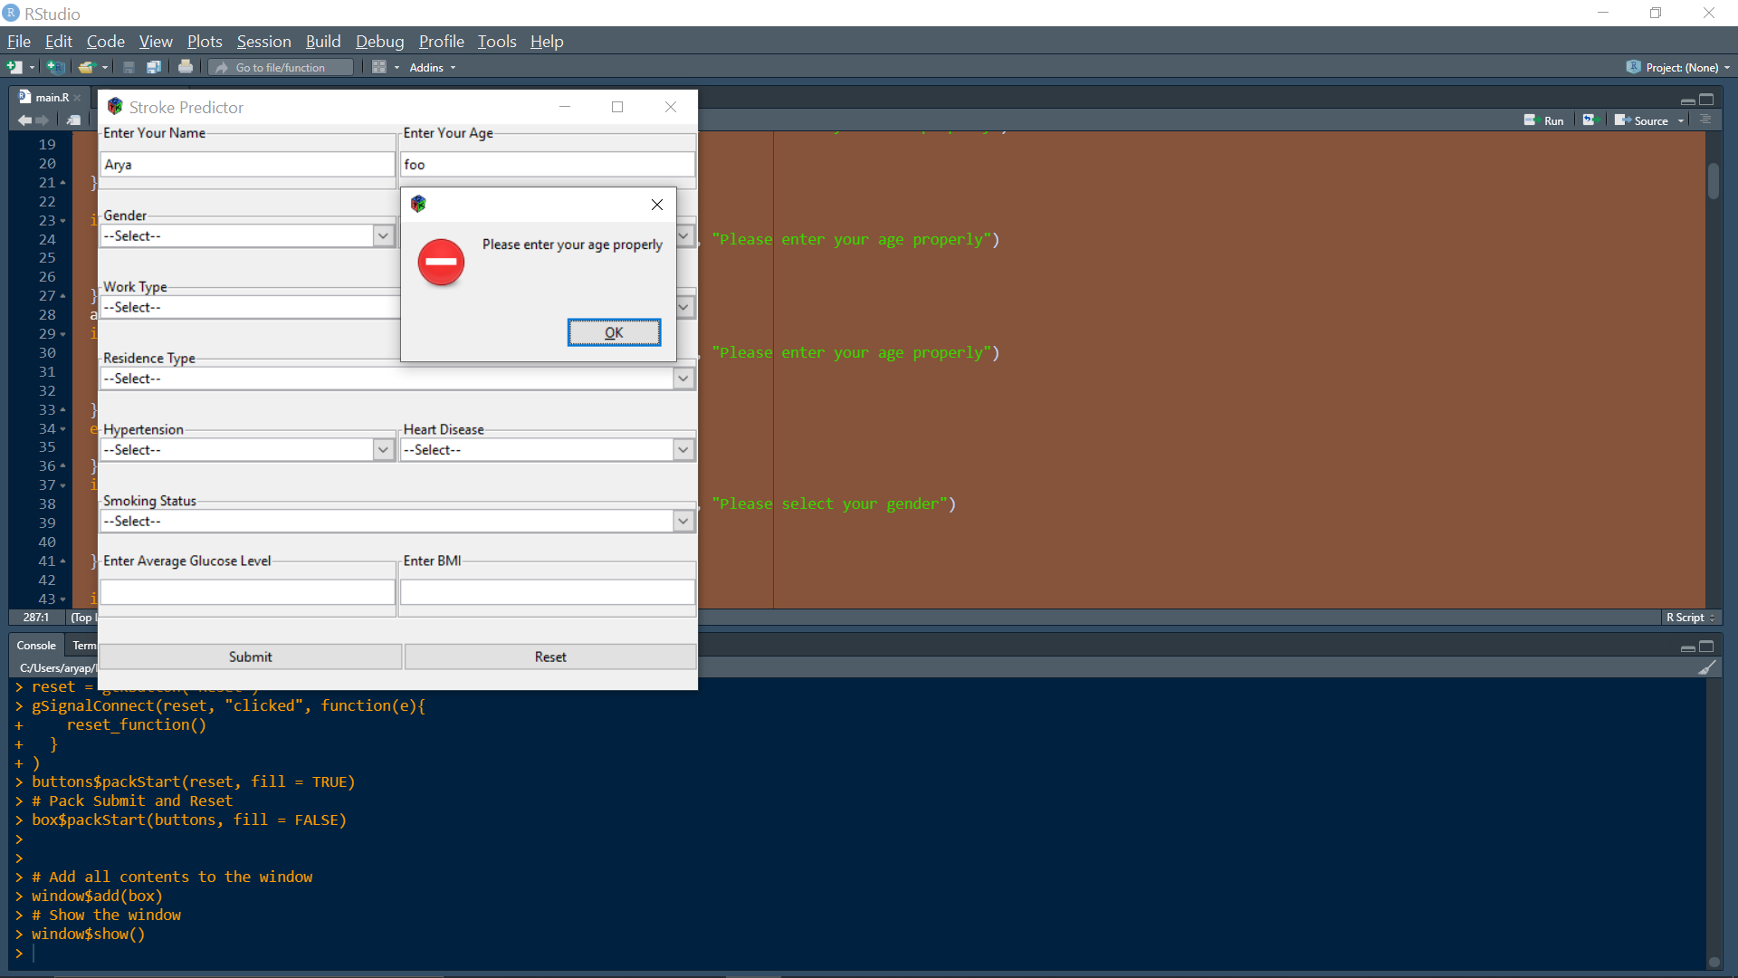
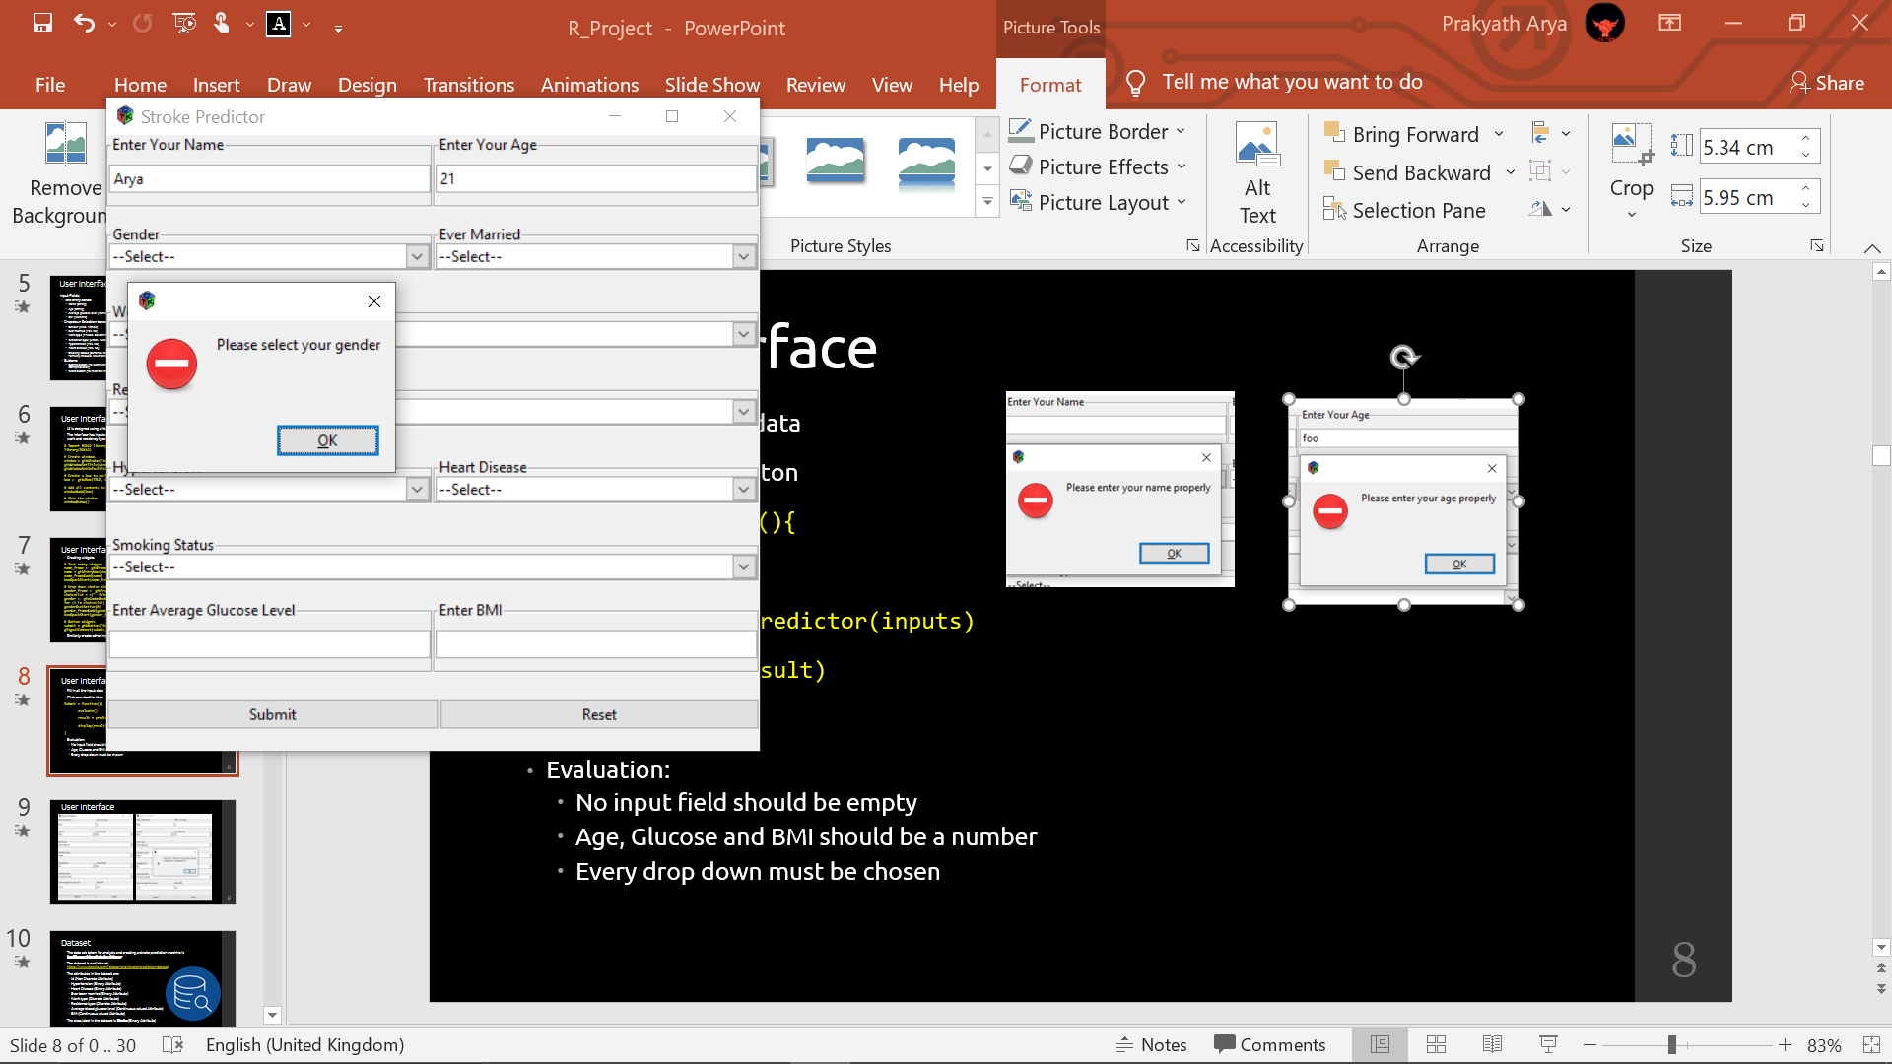
User Interface
Fill in all the input data
Click on submit button
Submit = function(){
evaluate()
result = predictor(inputs)
display(result)
}
Evaluation:
No input field should be empty
Age, Glucose and BMI should be a number
Every drop down must be chosen

Slide 13
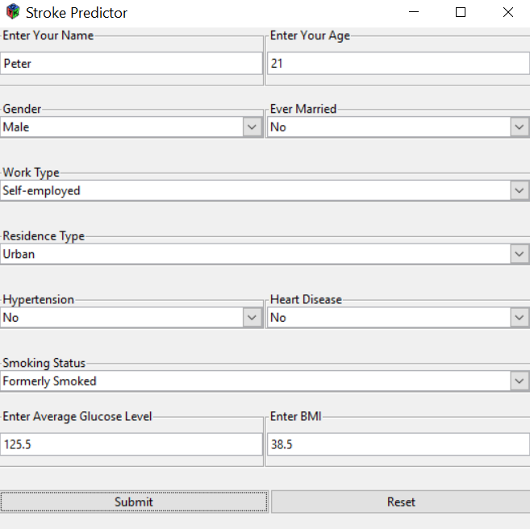
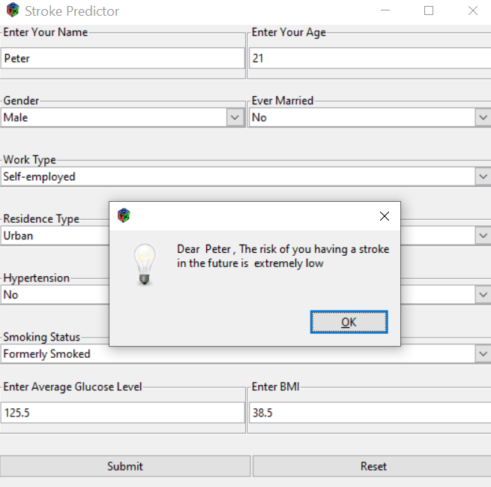
User Interface

Slide 14

Dataset
The data set taken for analysis and creating a stroke prediction machine is healthcare-dataset-stroke-data.csv
The dataset is available at: https://www.kaggle.com/fedesoriano/stroke-prediction-dataset
The attributes in the dataset are:
Id (Non Discrete Attribute)
Hypertension (Binary Attribute)
Heart Disease (Binary Attribute)
Ever been married (Binary Attribute)
Work type (Discrete Attribute)
Residence type (Discrete Attribute)
Average blood glucose level (Continuous valued Attribute)
BMI (Continuous valued Attribute)
The class label in the dataset is Stroke (Binary Attribute)

Slide 15
Data pre-processing
Load the dataset stroke_data_set = read.csv("stroke-dataset.csv")
Delete the id column dataset = stroke_data_set[, 2:12]
Rename the columns colnames(dataset) = c("gender", "age", "hyper", "heart", "marital", "worktype", "residence", "glucose", "bmi", "smoking", "stroke")
Data cleaning for all attributes{ dataset = subset(dataset, attribute != "N/A") }
Dataset has 5110 rows out of which only 180 records have label as 1 hence, we take only 400 records to prevent overfitting dataset = dataset[1:400, ]
BMI attribute is a string hence, convert it to numeric values dataset$bmi = as.numeric(dataset$bmi)

Slide 16
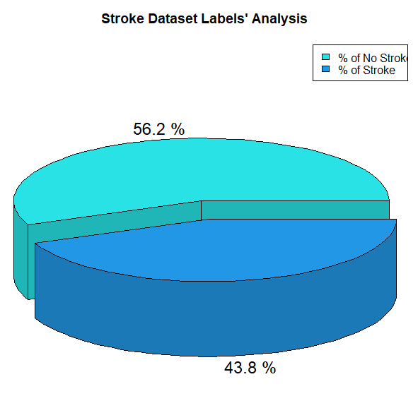
Data Analysis
Class label analysis using Pie Chart
library(plotrix)
stroke_data_set = read.csv("stroke-dataset.csv")
stroke_1 = nrow(dataset[dataset$stroke == 1,]) stroke_1_p = stroke_1 / nrow(dataset)) * 100
stroke_0 = nrow(dataset[dataset$stroke == 0,]) stroke_0_p = ((stroke_0 / nrow(dataset)) * 100
labels = c("% of No Stroke", "% of Stroke")
pie3D(c(stroke_0, stroke_1), labels = c(stroke_0_p, stroke_1_p), height=0.2, explode = 0.1, col=c(5, 4), main = "Stroke Dataset Labels' Analysis“ )
legend("topright", labels, fill=c(5, 4))

Slide 17
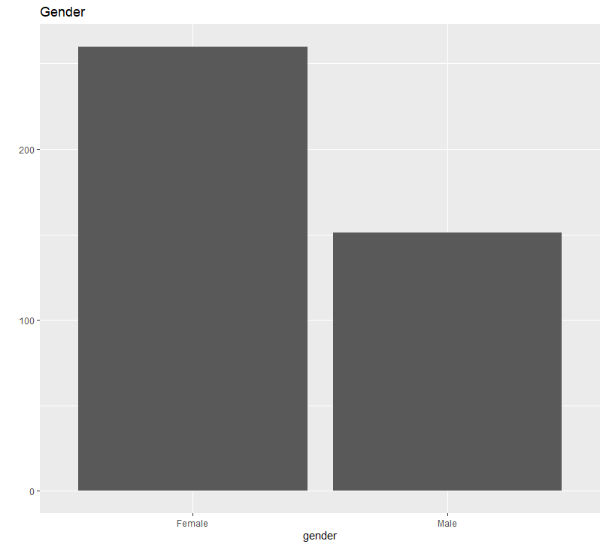
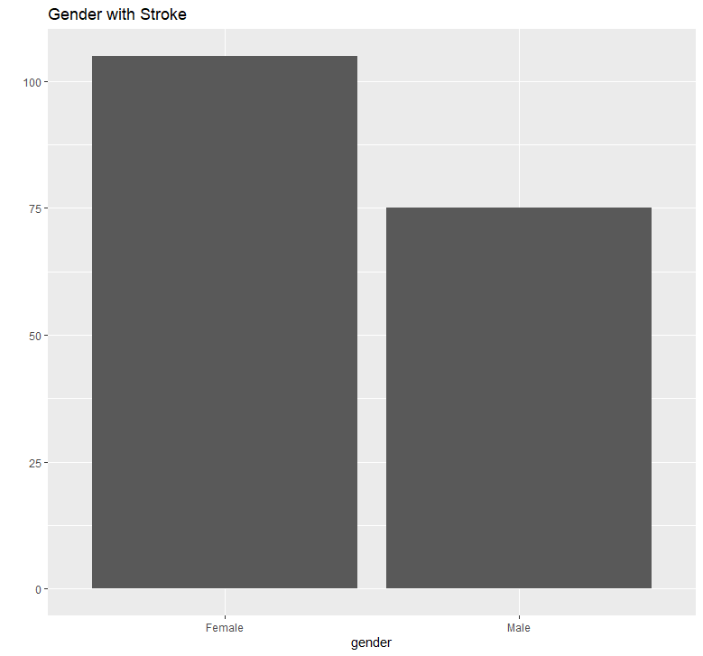
Data Analysis
Binary data analysis using Bar Graph
qplot(data=dataset, x=gender, main="Gender", bins=3)
stroke_positive = dataset[dataset$stroke == 1,] qplot(data=stroke_positive, x=gender, main="Gender with Stroke", bins=3)

Slide 18
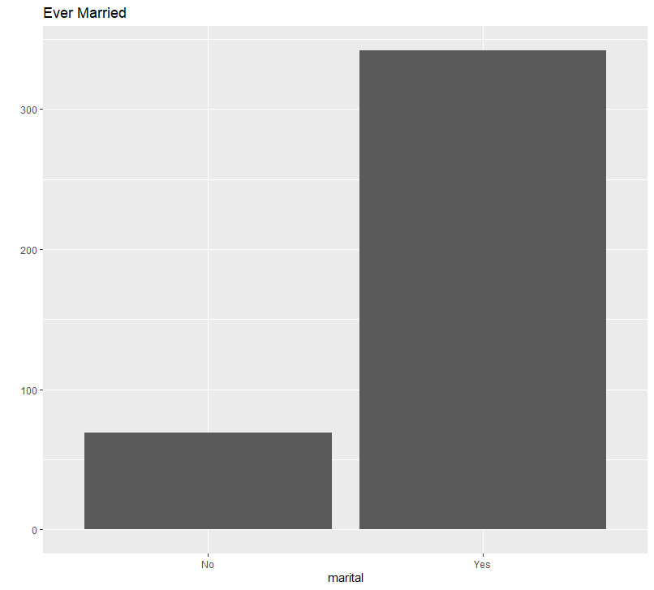
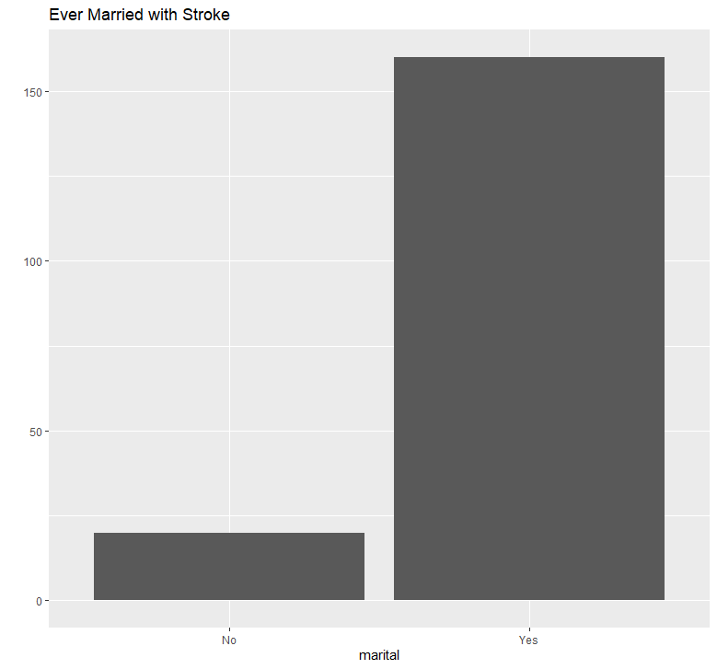
Data Analysis
qplot(data=dataset, x=marital, main="Ever Married", bins=4)
qplot(data=stroke_positive, x=marital, main="Ever Married with Stroke", bins=4)

Slide 19
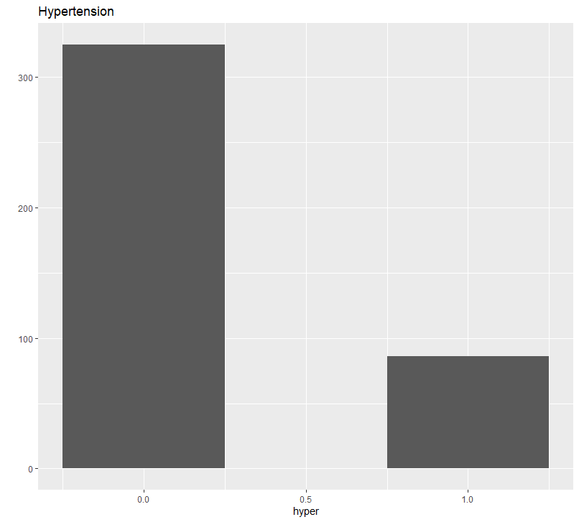
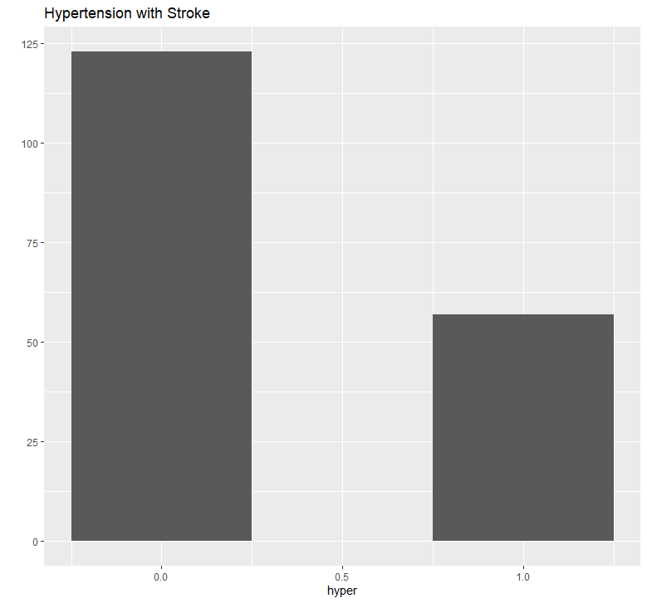
Data Analysis
qplot(data=dataset, x=hyper, main="Hypertension", bins=3)
qplot(data=stroke_positive, x=hyper, main="Hypertension with Stroke", bins=3)

Slide 20
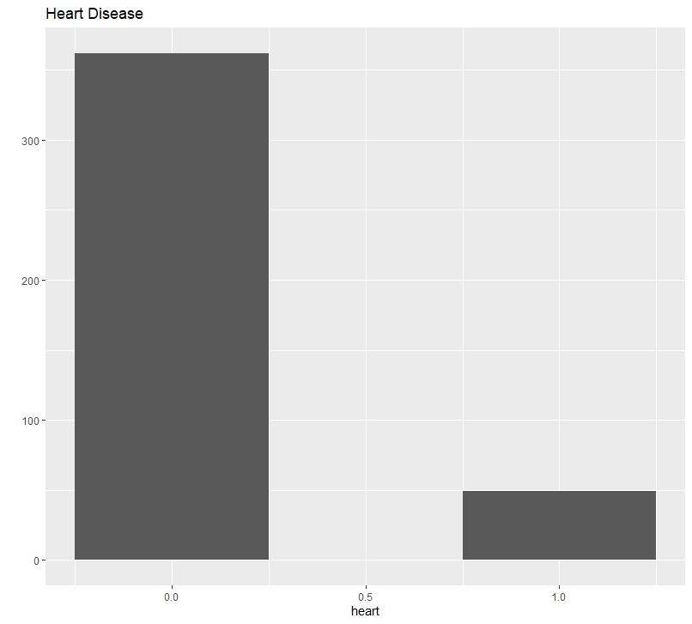
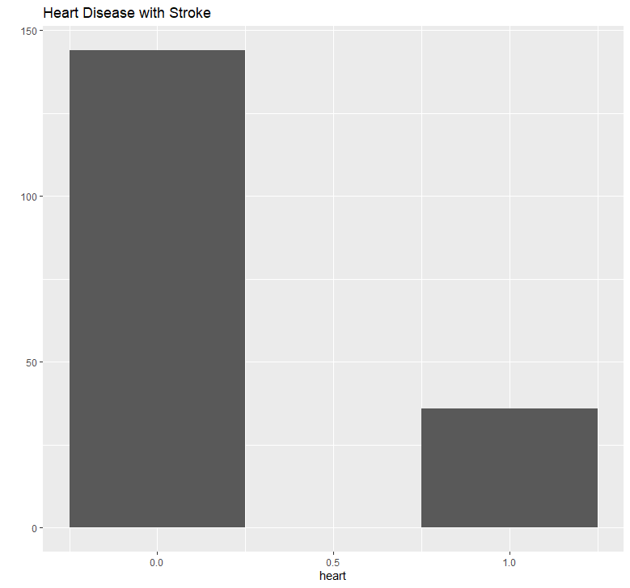
Data Analysis
qplot(data=dataset, x=heart, main="Heart Disease", bins=3)
qplot(data=stroke_positive, x=heart, main="Heart Disease with Stroke", bins=3)

Slide 21
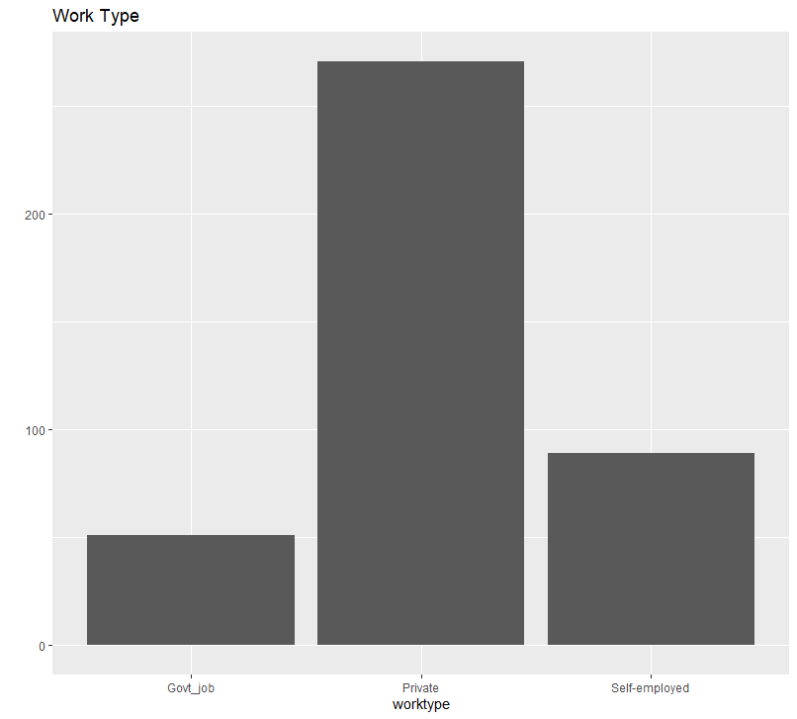
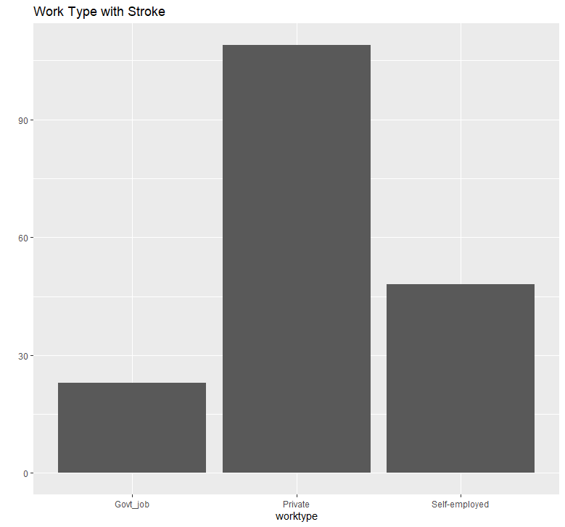
Data Analysis
qplot(data=dataset, x=worktype, main="Work Type", bins=4)
qplot(data=stroke_positive, x=worktype, main="Work Type with Stroke", bins=4)

Slide 22
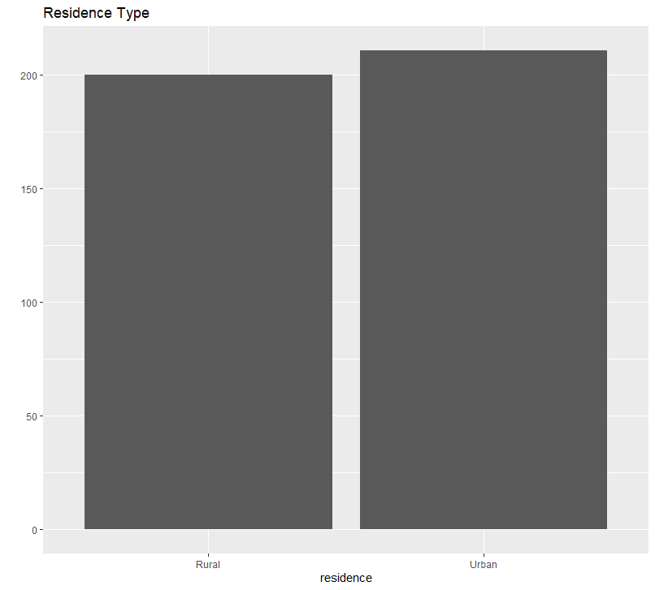
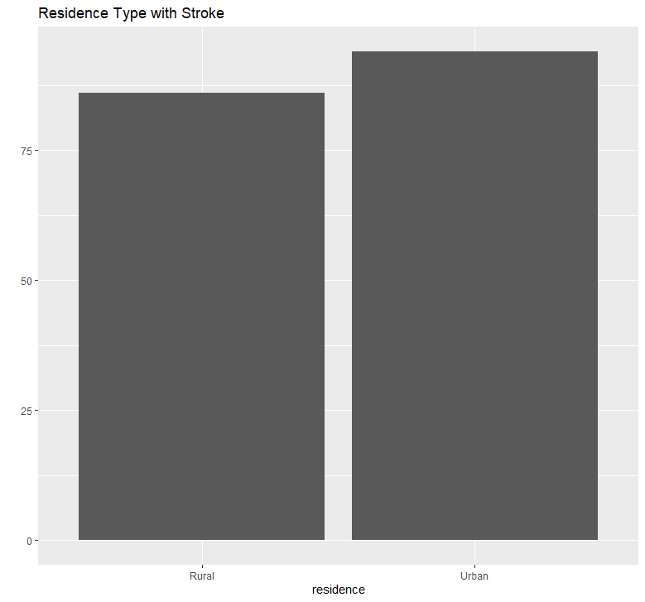
Data Analysis
qplot(data=dataset, x=residence, main="Residence Type", bins=4)
qplot(data=stroke_positive, x=residence, main="Residence Type with Stroke", bins=4)

Slide 23
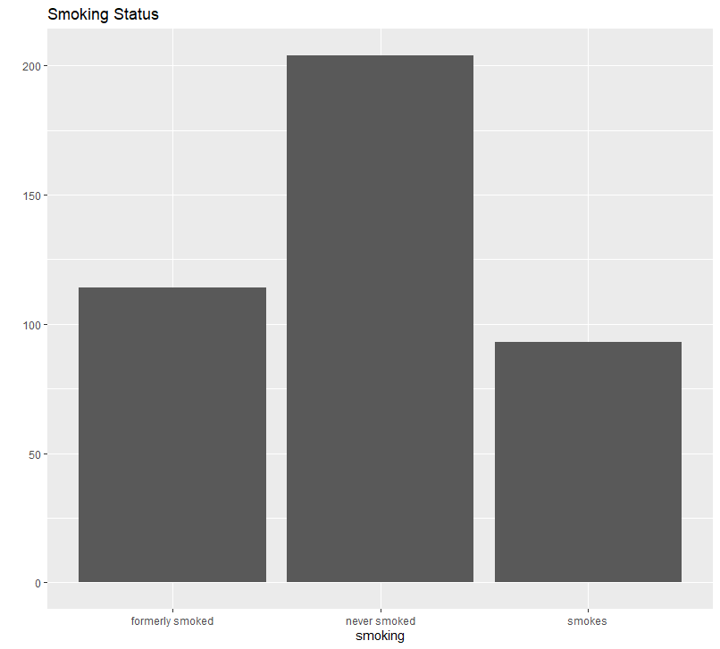
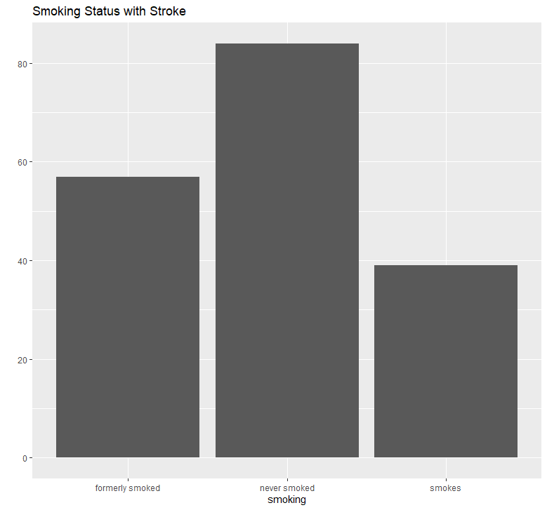
Data Analysis
qplot(data=dataset, x=smoking, main="Smoking Status", bins=5)
qplot(data=stroke_positive, x=smoking, main="Smoking Status with Stroke", bins=5)

Slide 24
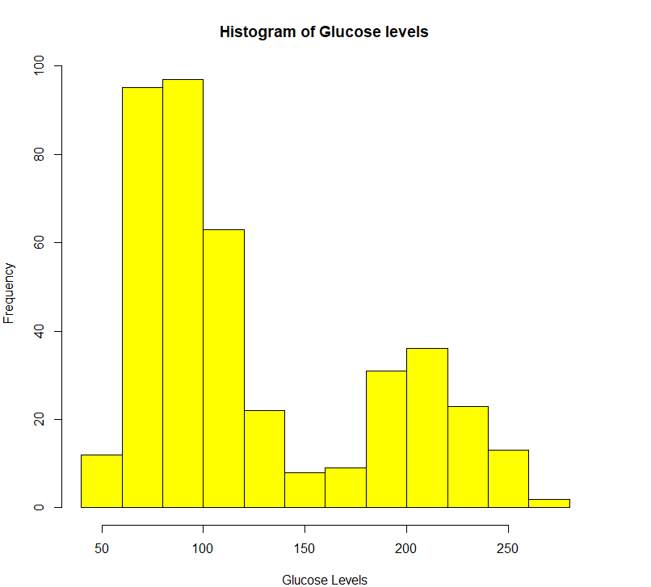
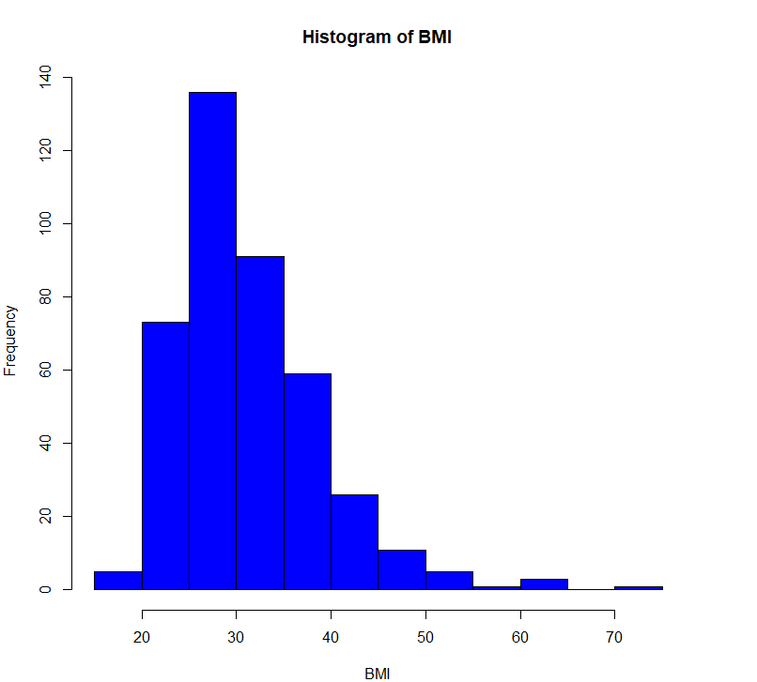
Data Analysis
Continuous data analysis using Histogram
hist(dataset$glucose, xlab="Glucose Levels", ylab="Frequency", col="yellow", border="black", main="Histogram of Glucose levels")
hist(dataset$bmi, xlab="BMI", ylab="Frequency", col="blue", border="black", main="Histogram of BMI")

Slide 25
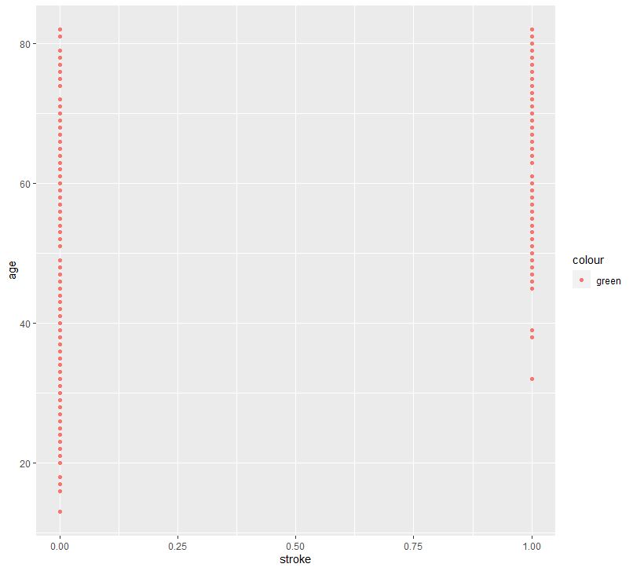
Data Analysis
Age analysis using scatter plot
ggplot(data=dataset, aes(x=stroke, y=age, color="green")) + geom_point()

Slide 26
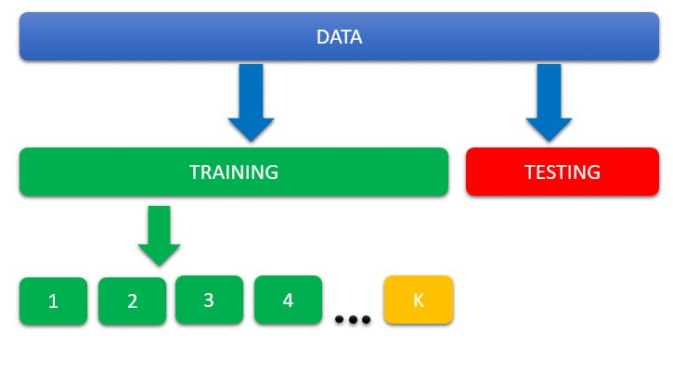
Training and Testing
The data is trained and tested with the algorithm to evaluate the performance
Shuffle the dataset to avoid overfitting and underfitting
set.seed(101) rows = sample(nrow(data_set)) data_set = data_set[rows, ]
We split the dataset into train set and test set in the ratio of 70:30
sample_set = sample.split(data_set, SplitRatio = 0.70) train_set = subset(data_set, sample_set == TRUE) test_set = subset(data_set, sample_set == FALSE)
model = training(train_set) testing(test_set, model)

Slide 27
Training
The data is trained using Logistic Regression and Decision Tree algorithms to choose the algorithm which has a better accuracy and least error rate.
Include libraries:
library(caTools)
library(rpart)
Training Logistic Regression model
training = function(train_set){ model = glm(formula = stroke ~ ., data = train_set) print("TRAINING DONE") return(model) }
Training Decision Tree model
training = function(train_set){ model = rpart(formula = stroke ~ ., data = train_set) print("TRAINING DONE") return(model) }

Slide 28
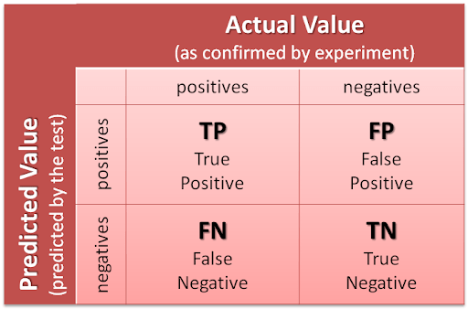
Testing
The trained model is tested and a confusion matrix is generated to evaluate it’s performance by calculating Accuracy and Error rate
Testing and finding confusion matrix
testing = function(test_set, model){ result = predict(model, test_set) result = (table(ActualValue=test_set$stroke, PreditedValue=result>=0.7)) print("TESTING DONE") print("Confusion Matrix") print(result) }
Calculate Accuracy and error
accuracy = (TP + TN) + (TP + TN + FP + FN) accuracy = accuracy * 100
error = (FP + FN) + (TP + TN + FP + FN) error = error * 100

Slide 29
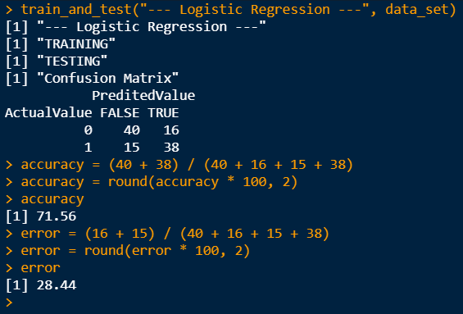
Performance
Logistic Regression Performance
Confusion Matrix
Accuracy
accuracy = (40 + 38) / (40 + 16 + 15 + 38) * 100 accuracy = 71.56 %
Error
error = (16 + 15) / (40 + 16 + 15 + 38) * 100 error = 28.44 %
 | Predicted Value
Actual Value | FALSE | TRUE
FALSE | 40 | 16
TRUE | 15 | 38

Slide 30
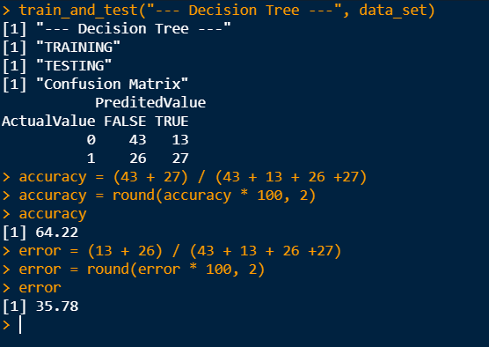
Performance
Decision Tree Performance
Confusion Matrix
Accuracy
accuracy = (43 + 27) / (43 + 13 + 26 + 27) * 100 accuracy = 64.22 %
Error
error = (13 + 26) / (43 + 13 + 26 + 27) * 100 error = 35.78 %
 | Predicted Value
Actual Value | FALSE | TRUE
FALSE | 43 | 13
TRUE | 26 | 27

Slide 31
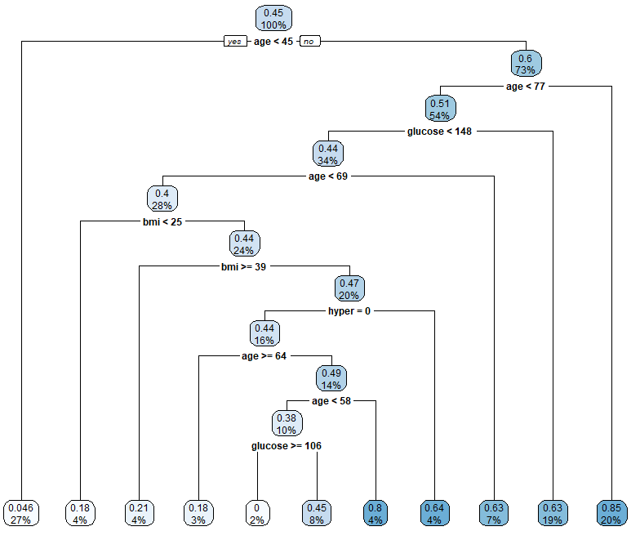
Performance
Plot the Decision Tree
library(rpart.plot)
rpart.plot(model)
The tree doesn't use most of the attributes like heart condition, hypertension etc.
Leads to underfitting
Logistic Regression is better.

Slide 32
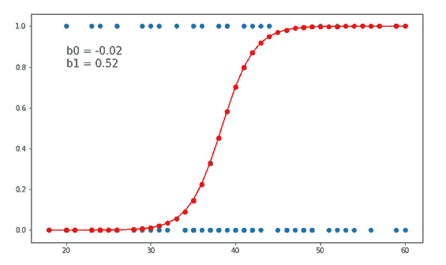
Performance
Logistic Regression model is about 7.34% more accurate than Decision Tree model.
The error rate of Decision Tree model is about 7.34% more than Logistic Regression model.
The tree is unstable, meaning that a small change in the data can lead to a large change in the structure of the decision tree.
Since the tree is not using most of the attributes the model gets underfitted and thus causes wrong predictions.
Hence, we go for Logistic Regression model.

Slide 33
Prediction
The user enters all the input data
The user clicks on submit button
Prediction() function will be called
predictor = function(age, gender, ever_married, work_type, residence_type, hypertension, heart_disease, smoking_type, glucose, bmi) {
inp = data.frame('gender'=gender, 'age'=age, 'hyper'=hypertension, heart'=heart_disease,'marital'=marital, 'worktype'=work_type, 'residence'=residence_type, 'glucose'=glucose, 'bmi'=bmi, 'smoking’=smoking_type)
result = predict(model, inp) return(as.numeric(result[1][1]))
}

Slide 34
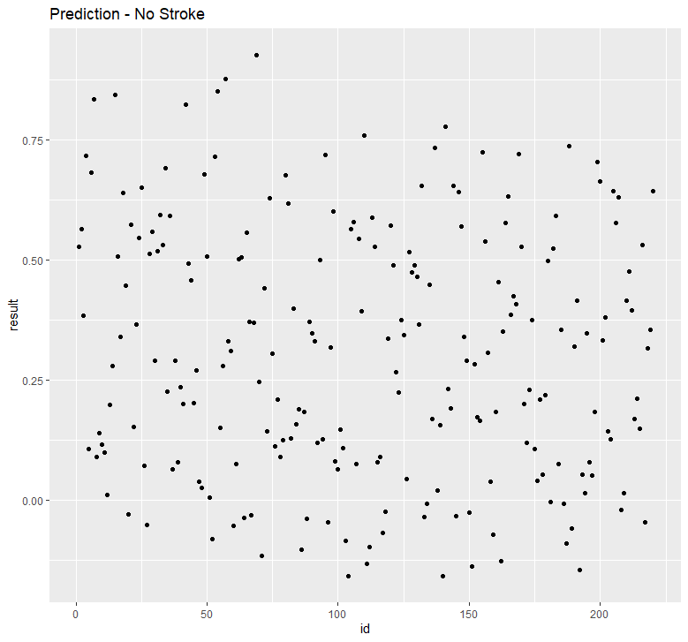
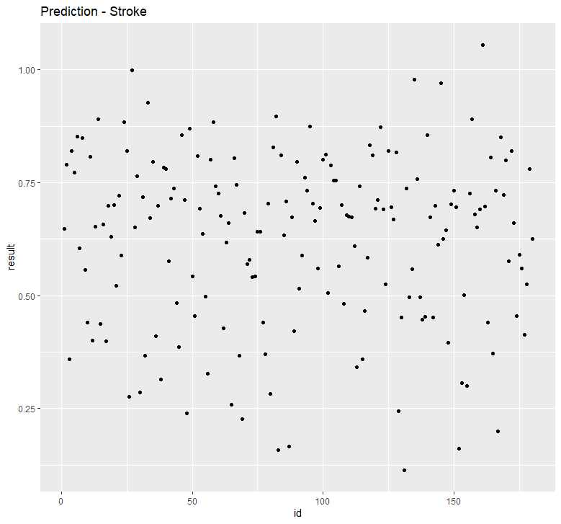
Prediction
Analysis of prediction
1
2
Extremely High
Extremely High
High
High
Moderate
Moderate
Low
Extremely Low
Low

Slide 35

Prediction
if(result<0.0) risk = "extremely low"
if(result>0.0 && result<=0.23) risk = "low"
if(result>0.23 && result<=0.48) risk = "moderate"
if(result>0.48 && result<=0.75) risk = "high"
if(result>0.75) risk = "extremely high"
result = paste("Dear ", gtkEntryGetText(name), "The risk of you having a stroke in the future is ", risk)
show = gtkMessageDialog(window, "destroy-with-parent", "info", "ok", result)

Slide 36
Output

Slide 37

Summary
Explained the idea our project
Explained the front end (UI)
How the data was analysed
Data set and Data pre-processing
Training and testing of data
Evaluating the performance of the model
Design and Development
Working

Slide 38

References
Michael Lawrence, Duncan Temple Lang “RGtk2: A Graphical User Interface Toolkit for R ”, Journal of Statistical Software, December 2010 https://core.ac.uk/reader/27052280
Official R Documentation: https://www.r-project.org/other-docs.html
Official ggplot Documentation: https://ggplot2.tidyverse.org/
Official plotrix Documentation: https://cran.r-project.org/web/packages/plotrix/plotrix.pdf
Official RGtk2 Documentation: https://rdrr.io/cran/RGtk2/man/

Slide 39

Demo of the working model

